Slide 1
Topic 10
Selection - Making Decisions

Slide 2
Making Decisions
Remember that the selection control structure allows you to choose between two or more alternatives.
It allows you to make decisions.
Decisions are represented by two values:
true
false
For example, a question such as “Is x greater than y?” gives an answer true (yes) or false (no).

Slide 3
Making Decisions
The values true and false represent logical data values.
C uses data type int to represent logical data values true and false.
The logical values are stored in computer memory as 0 for false and 1 for true.
Note: Any non-zero value represents true in C.
C++ has a data type called bool (for Boolean type) with values true and false.

Slide 4
Logical Expressions
C/C++ has 4 relational operators for creating logical expressions:
Relational Operator | Meaning | Logical Expression Example
< | Less than | x < y
> | Greater than | x > y
<= | Less than or equal to | x <= y
>= | Greater than or equal to | x >= y

Slide 5
Logical Expressions
C/C++ has 2 equality operators for creating logical expressions:
Equality Operator | Meaning | Logical Expression Example
== | Equal to | x == y
!= | Not equal to | x != y

Slide 6
Logical Expressions
C/C++ has 3 logical operators for combining logical expressions into more complex logical expressions:
The logical operators can be explained using truth tables.
Operator | Meaning | Logical Expression Example
&& | And | x < y && a > b
|| | Or | x < y || a > b
! | Not | ! (x < y )

Slide 7
Logical Expressions
Truth table for && (And) operator:
operand1 | operand2 | operand1 && operand2
true | true | true
true | false | false
false | true | false
false | false | false

Slide 8
Logical Expressions
Truth table for || (Or) operator:
operand1 | operand2 | operand1 || operand2
true | true | true
true | false | true
false | true | true
false | false | false

Slide 9
Logical Expressions
Truth table for ! (Not) operator:
operand1 | !operand1
true | false
false | true

Slide 10
Logical Expressions
Note that logical expressions with the ! operator can be written without it:
!(x > y) is the same as (x <= y)
!(x < y) is the same as (x >= y)
!(x <= y) is the same as (x > y)
!(x >= y) is the same as (x < y)
!(x == y) is the same as (x != y)
!(x != y) is the same as (x == y)

Slide 11
Operator Precedence
Operator | Precedence
( ) (parenthetical expressions) | highest
function calls
! + - & (unary operators)
* / %
+ -
< <= >= >
== !=
&&
||
= | lowest
Refer to full Table in WBLE

Slide 12
Operator Precedence
Examples:
x
y
z
flag
3.0
4.0
2.0
F
No. | Logical Expression Evaluation
1. | !flag !F T
T is true and F is false

Slide 13
Operator Precedence
Examples:
x
y
z
flag
3.0
4.0
2.0
F
No. | Logical Expression Evaluation
2. | x + y / z <= 3.5 3.0 + 4.0 / 2.0 <= 3.5 3.0 + 2.0 <= 3.5 5.0 <= 3.5 F

Slide 14
Operator Precedence
Examples:
x
y
z
flag
3.0
4.0
2.0
F
No. | Logical Expression Evaluation
3. | !flag || ( y + z >= x - z ) !F || (4.0 + 2.0 >= 3.0 - 2.0 ) !F || (4.0 + 2.0 >= 3.0 - 2.0 ) !F || ( 6.0 >= 3.0 - 2.0 ) !F || ( 6.0 >= 1.0 ) !F || T T || T T

Slide 15
Operator Precedence
Examples:
x
y
z
flag
3.0
4.0
2.0
0
No. | Logical Expression Evaluation
4. | ! ( flag || ( y + z >= x - z ) ) ! ( 0 || (4.0 + 2.0 >= 3.0 - 2.0 ) ) ! ( F || ( 6.0 >= 1.0 ) ) ! ( F || T ) ! ( T ) F

Slide 16
Short-Circuit Evaluation
Remember that:
true || anything always gives true
For the logical expression:
flag || y >= x
If flag is true, the result of the whole expression can be determined as true since true || anything is always true.
There is no need to evaluate the second part (y >= x) of the expression.
C/C++ uses this method to evaluate logical expressions. This method is called short-circuit evaluation.

Slide 17
Short-Circuit Evaluation
Also remember that:
false && anything always gives false
For the logical expression:
flag && (x > z)
If flag is false, the result of the whole expression can be determined as false since false && anything is always false.
Again, there is no need to evaluate the second part (x > z) of the expression.

Slide 18
Short-Circuit Evaluation
Short-circuit evaluation works as follows:
If the logical expression contains a || or && operator, the first operand of this operator is evaluated first.
If the result of the whole expression can be determined based on the evaluation of the first operand, the second operand will be ignored.
Otherwise the second operand will be evaluated.

Slide 19
Short-Circuit Evaluation
Examples:
x
y
z
flag
3.0
4.0
2.0
0
No. | Logical Expression Evaluation
1. | !flag || ( y + z >= x - z ) !0 || (4.0 + 2.0 >= 3.0 - 2.0 ) !F || (4.0 + 2.0 >= 3.0 - 2.0 ) T || (4.0 + 2.0 >= 3.0 - 2.0 ) T
second operand evaluation skipped

Slide 20
Short-Circuit Evaluation
Examples:
x
y
z
flag
3.0
4.0
2.0
0
No. | Logical Expression Evaluation
2. | x >= y && z + y 3.0 >= 4.0 && 2.0 + 4.0 F && 2.0 + 4.0 F
second operand evaluation skipped

Slide 21
Short-Circuit Evaluation
Examples:
x
y
z
flag
3.0
4.0
2.0
0
No. | Logical Expression Evaluation
3. | x == y || z != 0.0 3.0 == 4.0 || 2.0 != 0.0 F || 2.0 != 0.0 F || 2.0 != 0.0 F || T T
second operand evaluated

Slide 22
English Conditions - Logical Expressions
No. | English Condition | Logical Expression | Incorrect Expression
1. | x and y are greater than z | x > z && y > z | x && y > z
2. | x is equal to 2.0 or 3.0 | x == 2.0 || x == 3.0 | x == 2.0 || 3.0
3. | x is in the range y to z inclusive | y <= x && x <= z | y <= x <= z
4. | x is outside the range y to z | !(y <= x && x <= z) or x < y || x > z | !(y <= x <= z)

Slide 23
English Conditions - Logical Expressions
Note that the logical expression:
x && y > z
is an incorrect interpretation of the English condition but it is still valid in C/C++.
How does C/C++ evaluate this expression?
Suppose x = 10.0, y = 2.0, and z = 5.0
Then the expression becomes:
10.0 && 2.0 > 5.0
=> T && F
=> F
Remember in C/C++ a non-zero value is true.

Slide 24
Comparing Characters
Logical Expression | Value
'9' >= '0' | true
'a' <= 'e' | true
'B' <= 'A' | false
'Z' == 'z' | false
'A' <= 'a' | system dependent (true on most systems)
'a' <= ch && ch <= 'z' | true if ch is a lowercase letter

Slide 25
ASCII Code
Characters are stored in the computer using a coding system.
A common coding system is ASCII (American Standard Code for Information Interchange) – refer to Chart.
The characters ‘0’ to ‘9’, ‘A’ to ‘Z’, ‘a’ to ‘z’ and some other characters have these code:
Characters | ASCII Code
'0', '1', '2', . . . , '9' | 48, 49, 50, . . . , 57
'A', 'B', 'C', . . . , 'Z' | 65, 66, 67, . . . , 90
'a', 'b', 'c', . . . , 'z' | 97, 98, 99, . . . , 122
'[', '\', ']', '^', '_' | 91, 92, 93, 94, 95

Slide 26
Logical Variables and Assignment
In C++, we use the data type bool to represent logical variables with values true and false to represent true and false.
Example:
bool senior_citizen;
senior_citizen = true;
The logical variable can then be used in logical expressions.
Example:
senior_citizen && age > 80

Slide 27
Logical Variables and Assignment
A logical variable can also be assigned a logical expression.
Example:
bool in_range, is_letter, is_even;
in_range = (n > -10 && n < 10);
is_letter = ('A' <= ch && ch <= 'Z') ||
('a' <= ch && ch <= 'z');
is_even = (n % 2 == 0);

Slide 28
DeMorgan’s Rule
A logical expression with the ! (Not) operator in front can be simplified to make it easier to understand.
Example:
! ( x == y ) can be simplified to ( x != y )
For more complicated expressions such as
! ( status == 'S' && age > 25 )
DeMorgan’s rule can be applied to simplify them.

Slide 29
DeMorgan’s Rule
DeMorgan’s rule:
! ( expr1 && expr2 ) is written as ( !expr1 || !expr2 )
! ( expr1 || expr2 ) is written as ( !expr1 && !expr 2)
For the logical expression:
! ( status == 'S' && age > 25 )
we write it as:
(! (status == 'S') || !(age > 25) )
=> ( (status != 'S') || ( age <= 25 ) )

Slide 30
Two-Way Selection
The basic decision statement in the computer is the two-way selection.
In a two-way selection, the decision is determined by a condition which has either a true or false value.
If the decision value is true, one action is executed.
If the decision value is false, a different action is executed instead.
After either action is completed, the next action after the selection is executed.

Slide 31
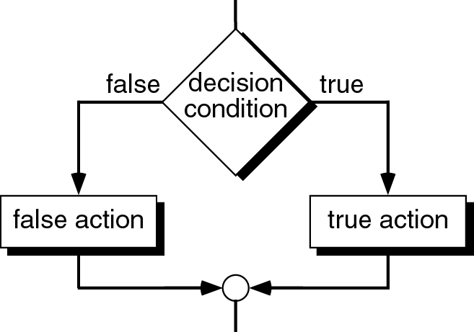
Two-Way Selection
A flowchart can be used to show the selection structure or logical/control flow.
The flowchart symbol for decision is
Example:

Slide 32
The if-else Statement
C/C++ implements two-way selection with the if-else statement.
An if-else statement is a composite statement used to make a decision between two alternatives.
The decision condition is described by an expression which evaluates to either zero (false) or not-zero (true).

Slide 33
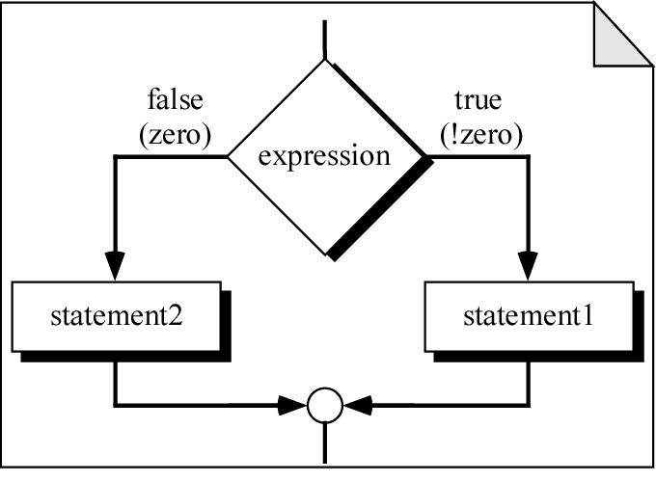
The if-else Statement
if (expression)
statement-1;
else
statement-2;
Logical flow
Code

Slide 34
The if-else Statement
Syntax rules:
The expression for the decision condition must be enclosed in parentheses.
if (expression)
statement-1;
else
statement-2;
The if-else parts do not need semicolon (;)
Semicolons are needed for the statements for the true and false actions.

Slide 35
The if-else Statement
Program style:
if (expression)
statement-1;
else
statement-2;
Statements for the true and false parts are indented.

Slide 36
The if-else Statement
Example:
if (gender == 'M')
cout << "Male";
else
cout << "Female";
cout << " Student";
The output is either:
Male Student or Female Student
(if gender is 'M') (if gender is not 'M‘ e.g. if is 'F')

Slide 37
Compound Statement
A compound statement is a group of statements enclosed in braces.
Example:
{
statement-1;
statement-2;
.
.
.
statement-n;
}

Slide 38
if-else Statement with Compound Statement
Compound statements are used for function bodies.
If the actions to be performed for either of the alternatives in an if-else statement involve multiple statements, a compound statement must be used.
The compound statement is treated as one statement.

Slide 39
if-else Statement with Compound Statement
Example: if (ctri <= MAX_SAFE_CTRI)
{
cout << "Car is safe\n";
safe = safe + 1;
}
else
{
cout << "Car is unsafe\n";
unsafe = unsafe + 1;
}

Slide 40
if-else Statement with Compound Statement
Program style – alternative style:
if (ctri <= MAX_SAFE_CTRI) {
cout << "Car is safe\n";
safe = safe + 1;
} else {
cout << "Car is unsafe\n";
unsafe = unsafe + 1;
}

Slide 41
if-else Statement with Compound Statement
Example: if (deduct <= balance)
{
balance = balance – deduct;
cout << "New balance is " << balance << endl;
}
else
cout << "Insufficent balance\n";

Slide 42
One-Way Selection
Sometimes there is only one statement which is either executed or it is skipped.
This is a one-way selection.
C/C++ implements one-way selection with a if statement without the else part.

Slide 43
The if Statement
if (expression)
statement;
Logical flow
Code

Slide 44
The if Statement
Example:
if (count != 0)
average = sum / count;
Example with compound statement:
if (new_pop > old_pop)
{
growth = new_pop – old_pop;
growth_pct = growth / old_pop * 100.0;
cout << "Growth is " << growth-pct
<< " percent\n";
}

Slide 45
Desk-Checking if Statements
Example of desk-checking or hand-tracing if statement:
if ( x > y ) {
temp = x;
x = y;
y = temp;
}
Statement Part | condition | x | y | temp
 |  | 12.5 | 5.0 | ?
if ( x > y ) { | 12.5 > 5.0 is true | 12.5 | 5.0 | ?
temp = x; |  | 12.5 | 5.0 | 12.5
x = y; |  | 5.0 | 5.0 | 12.5
y = temp; } |  | 5.0 | 12.5 | 12.5

Slide 46
Selection in Pseudocode
The pseudocode for two-way selection may be written as follows:
if condition
true action
else
false action
The pseudocode for one-way selection may be written as follows:
if condition
true action

Slide 47
Complementing a Condition
If you want to do something only when a condition is not true, rewrite the condition by getting its complement or negation.
Example in pseudocode:
if count <= 5
do nothing
else
do something
Get the complement or negation of the condition.
if count > 5
do something

Slide 48
Common Mistakes
If you write a semicolon at the end of the if part of the if or if-else statement, the C/C++ compiler interprets it as a null statement.
Example:
if (x == 0) ;
cout << "x is zero!\n";
The C compiler understands it as:
if (x == 0)
;
cout << "x is zero!\n";
The output is always displayed whether x is zero or not.
Should not have semicolon here.
This is a null or empty statement.

Slide 49
Common Mistakes
Using the assignment operator (=) instead of the equality operator (==) is another common error.
Example:
if (x = 0)
cout << "x is zero!\n";
The C/C++ compiler evaluates the assignment expression.
The value of the assignment expression is the value assigned.
Thus for the example above, the expression value is 0 (false).
Should be ==.

Slide 50
Case Study 1
Problem:
Develop a program that performs addition or subtraction of two numbers based on the user’s choice.
Understand the problem:
A sample input and output for the program is as follows:
Enter two numbers: 35.0 57.0
Do you want to add or subtract?
(Enter a to add and s to subtract): a
The result is 92.0

Slide 51
Case Study 1
Design the solution:
Algorithm
1. Get the two numbers.
2. Get the operation choice.
3. If the operation choice is to add
The result is the sum of the two numbers.
else
The result is the difference of the two numbers.
4. Display the result.

Slide 52
Case Study 1 – Complete Program
/*
* Takes two numbers and performs either
* addition or subtraction of the two numbers
* based on the user choice.
*/
#include <iostream>
using namespace std;
int main(void)
{
double num1, num2; // input
char choice; // input
double result; // output

Slide 53
Case Study 1 – Complete Program
cout << "Enter two numbers: ";
cin >> num1 >> num2;
cout << "Do you want to add or subtract?\n"
<< "Enter a to add or s to subtract: ";
cin >> choice;
if (choice == 'a')
result = num1 + num2;
else
result = num1 - num2;
cout << "The result is " << result << endl;
return 0;
}

Slide 54
Case Study 2
Suppose we change the program to allow the user to enter lowercase or upper case letters for the choice i.e. ‘a’ or ‘A’ or ‘s’ or ‘S’.
Also we want to display either one of the 2 messages:
- Sum of n1 and n2 is n3
- Difference of n1 and n2 is n3
where n1 and n2 are the input numbers and n3 is the result.

Slide 55
Case Study 2 – Complete Program
/*
* Takes two numbers and performs either
* addition or subtraction of the two numbers
* based on the user choice.
*/
#include <iostream>
using namespace std;
int main(void)
{
double num1, num2; // input
char choice; // input
double result; // output
cout << "Enter two numbers: ";
cin >> num1 >> num2;

Slide 56
Case Study 2 – Complete Program
cout << "Do you want to add or subtract?\n";
<< "Enter a to add or s to subtract: ";
cin >> choice;
if (choice == 'a' || choice == 'A')
{
result = num1 + num2;
cout << "Sum of " << num1 << " and "
<< num2 << " is " << result << endl;
}
else
{
result = num1 - num2;
cout << "Difference of " << num1 << " and "
<< num2 << " is " << result << endl;
}
return 0;
}

